Slide 1
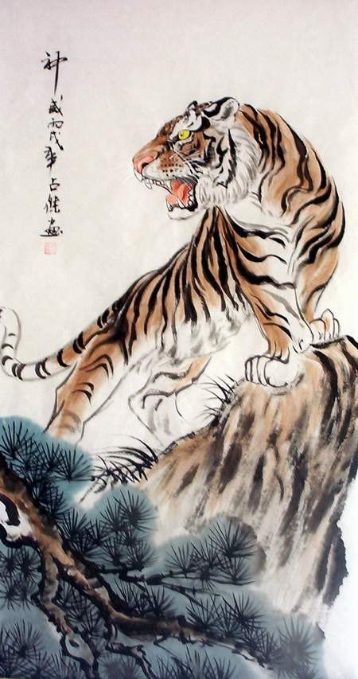
The Jungle Game
Chesshire Coders
Image from: http://www.tattoodaze.com/tattoo-images/79/th_tiger-art-decor-mountain-tiger-tiger-hand-painting-original-bkLbwV.jpg

Slide 2








Description of The Jungle Game
The Jungle Game is the english name for a traditional Chinese game called Dou Shou Qui.
Jungle is a two-player strategy game.
Each player starts with eight pieces.
Rat
Cat
Fox
Dog
Leopard
Tiger
Lion
Elephant
The higher the piece’s number, the more powerful it is.
Images from: http://liacs.leidenuniv.nl/~visjk/doushouqi/about.html

Slide 3
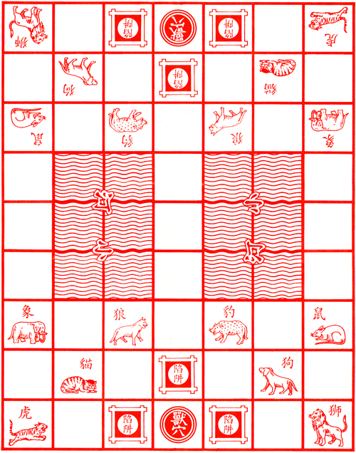



Jungle - The Board
The Jungle game board is a set of 7 by 9 squares.
With three important kinds of squares.
The “Den” Square
A “River”
https://upload.wikimedia.org/wikipedia/commons/2/2f/Dou_shou_qi_den.png
The “Trap” Squares
https://upload.wikimedia.org/wikipedia/commons/a/a4/Dou_shou_qi_river.png
https://upload.wikimedia.org/wikipedia/commons/d/d0/Dou_shou_qi_board.png
https://upload.wikimedia.org/wikipedia/commons/d/d8/Dou_shou_qi_traps.png

Slide 4
Jungle Rules
To win Jungle one of the players must move any of their pieces to occupy the same square as the enemy Den.
A player can move any creature one horizontal or vertical space each turn.
If any animal stops on an enemy animal with an equal or lower number, the lower animal is removed from the game. Except for the Rat who may capture the Elephant, and the Elephant who may not capture the Rat.
Rat
But, Never Diagonally.
Elephant
Images from: http://liacs.leidenuniv.nl/~visjk/doushouqi/about.html

Slide 5
Jungle Rules - Continued
The Lion and the Tiger are the only creatures which can “jump” the river. Moving vertically or horizontally across the water, directly to the space across from them..
The Rat is the only creature which may enter the water. The Rat may not enter the same square of an animal when leaving or entering the water.
Rat
River
Only if there are no animals in any space they cross.
But, they can land on an enemy animal with an equal or lower number, or power, than themselves, defeating them like normal.
https://upload.wikimedia.org/wikipedia/commons/a/a4/Dou_shou_qi_river.png
Images from: http://liacs.leidenuniv.nl/~visjk/doushouqi/about.html unless otherwise noted.

Slide 6
Jungle Rules - Finished
Although the animals can only defeat enemies less powerful, or lower in number, than themselves. There is a space which makes all creatures vulnerable.
Any creature which occupies the same square as an enemy trap space may be captured by any other enemy animal. There is no limit to this weakness, from Rat to Elephant.
The “Trap” Squares
https://upload.wikimedia.org/wikipedia/commons/d/d8/Dou_shou_qi_traps.png

Slide 7
Product Choices - Game
Strategy:
The lowest piece may capture the highest piece, but not vice versa.
Any animal within its own trap may be captured by any other animal.
The game will end if the a den is captured or if all animals controlled by a player are taken.
Only the rat may enter the water.
Style:
The piece with a strength of 3 would be named fox, not wolf.
Art style will be decided once a more concrete UI concept is developed.
Notes:
Obviously we need to do if all animals are captured, but it’s good to say for the sake of completion
Only the rat may enter water to make water more difficult, and for the ease of design.
We renamed the wolf to fox, because a single dog is weaker than a single wolf, which is in opposition to the goal of the game. Renaming it brings it back into logical understanding.

Slide 8
Actors and Stakeholders
Owner
Primary interest in a fun and secure game.
Unregistered Users
No accounts, no ability to use system
Registered Users
Full account, which is not currently being accessed.
Logged In Users
Create games, view profiles, etc.
Players
People who are in at least one active game

Slide 9
Use Cases
Unregistered
Register to the system
Registered User
Log in to System
Player
<<inherits from Logged in User>>
Create a new game
Invite other users to a game
Respond to Game Invitation
Move Game Piece
Switch Game
Quit Game
Logged in User
<<inherits from Registered User>>
View Player Profile
Unregister from System
Log out of System

Slide 10
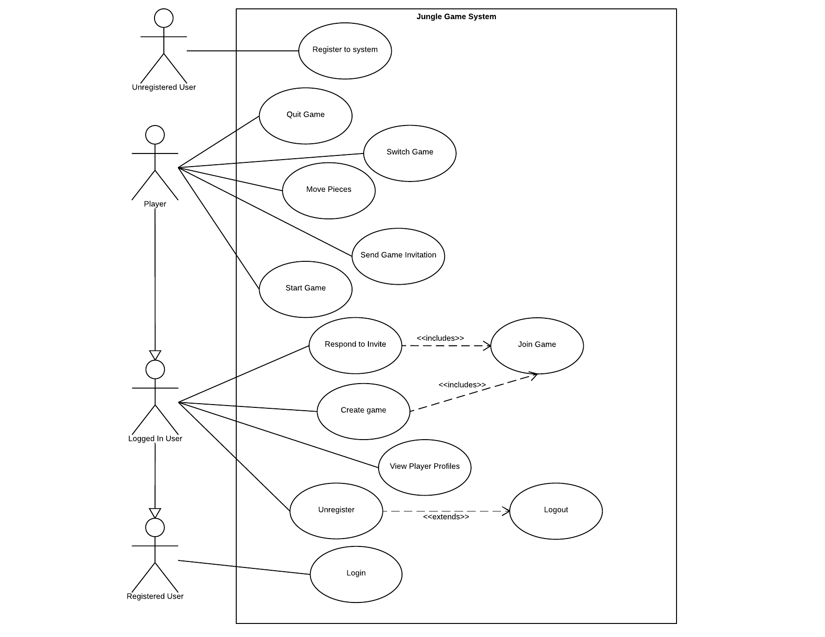
Use Case Diagram
Notes:
Logged in user is an extension of a registered user, and a player is an extension of a logged in user (one who is in a game).

Slide 11
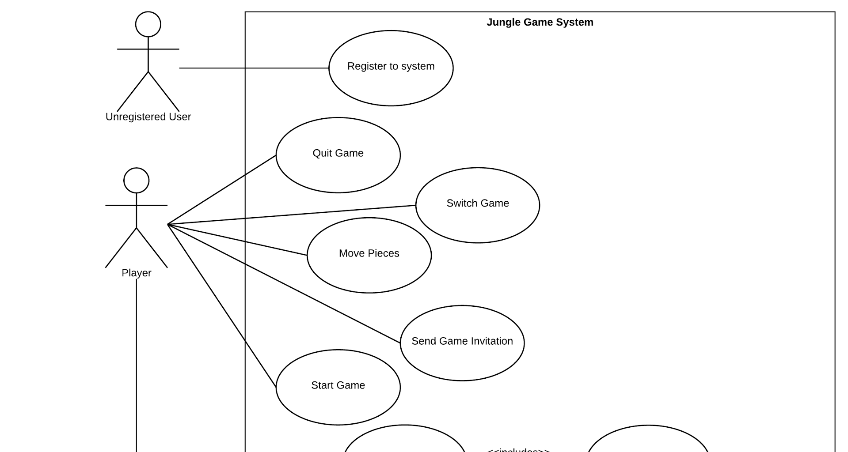
Use Case Diagram

Slide 12
Use Case Diagram

Slide 13
Product Choices - System
Any Player who quits early will automatically receive a loss unless their opponent has not moved a piece within a specified amount of time
A game will automatically end if a Player does not make a move within a specified amount of time
Game Platform
Java Executable (Our Preferred Platform)
Mobile App
Web App
Notes:
How does it work?
Design for a Java executable supported by an online network and distributed by one of the various sites available online?
Design for a online based game hosted by one of the available systems?
We will be prioritizing the system development as we further model the system and understand the strengths of each model?

Slide 14
Process Decisions
We are prioritizing a focus on robust code backed by tools designed to reinforce safe and clean code, and encouraged by various meetings through the week.
Tools
Travis Cl
Better Code Hub
Waffle
Slack
Process
Agile with Scrum-influences
We believe communication is a key factor in well-built software. Iterative processes encourage this communication while promoting increased testing.
Notes:
Our highest priority: robust code. We chose our tools and process model with that in mind.
Continuous Integration: Travis
Code inspection: Better Code Hub
Project Management: Waffle and Slack
Process: Agile with Scrum influences (regular meetings, code review, and communication)
We believe communication is key to creating well-built software
Iterative process encourages communication with the customer and with each other.

Slide 15
Questions
And
Discussions

